Slide 1
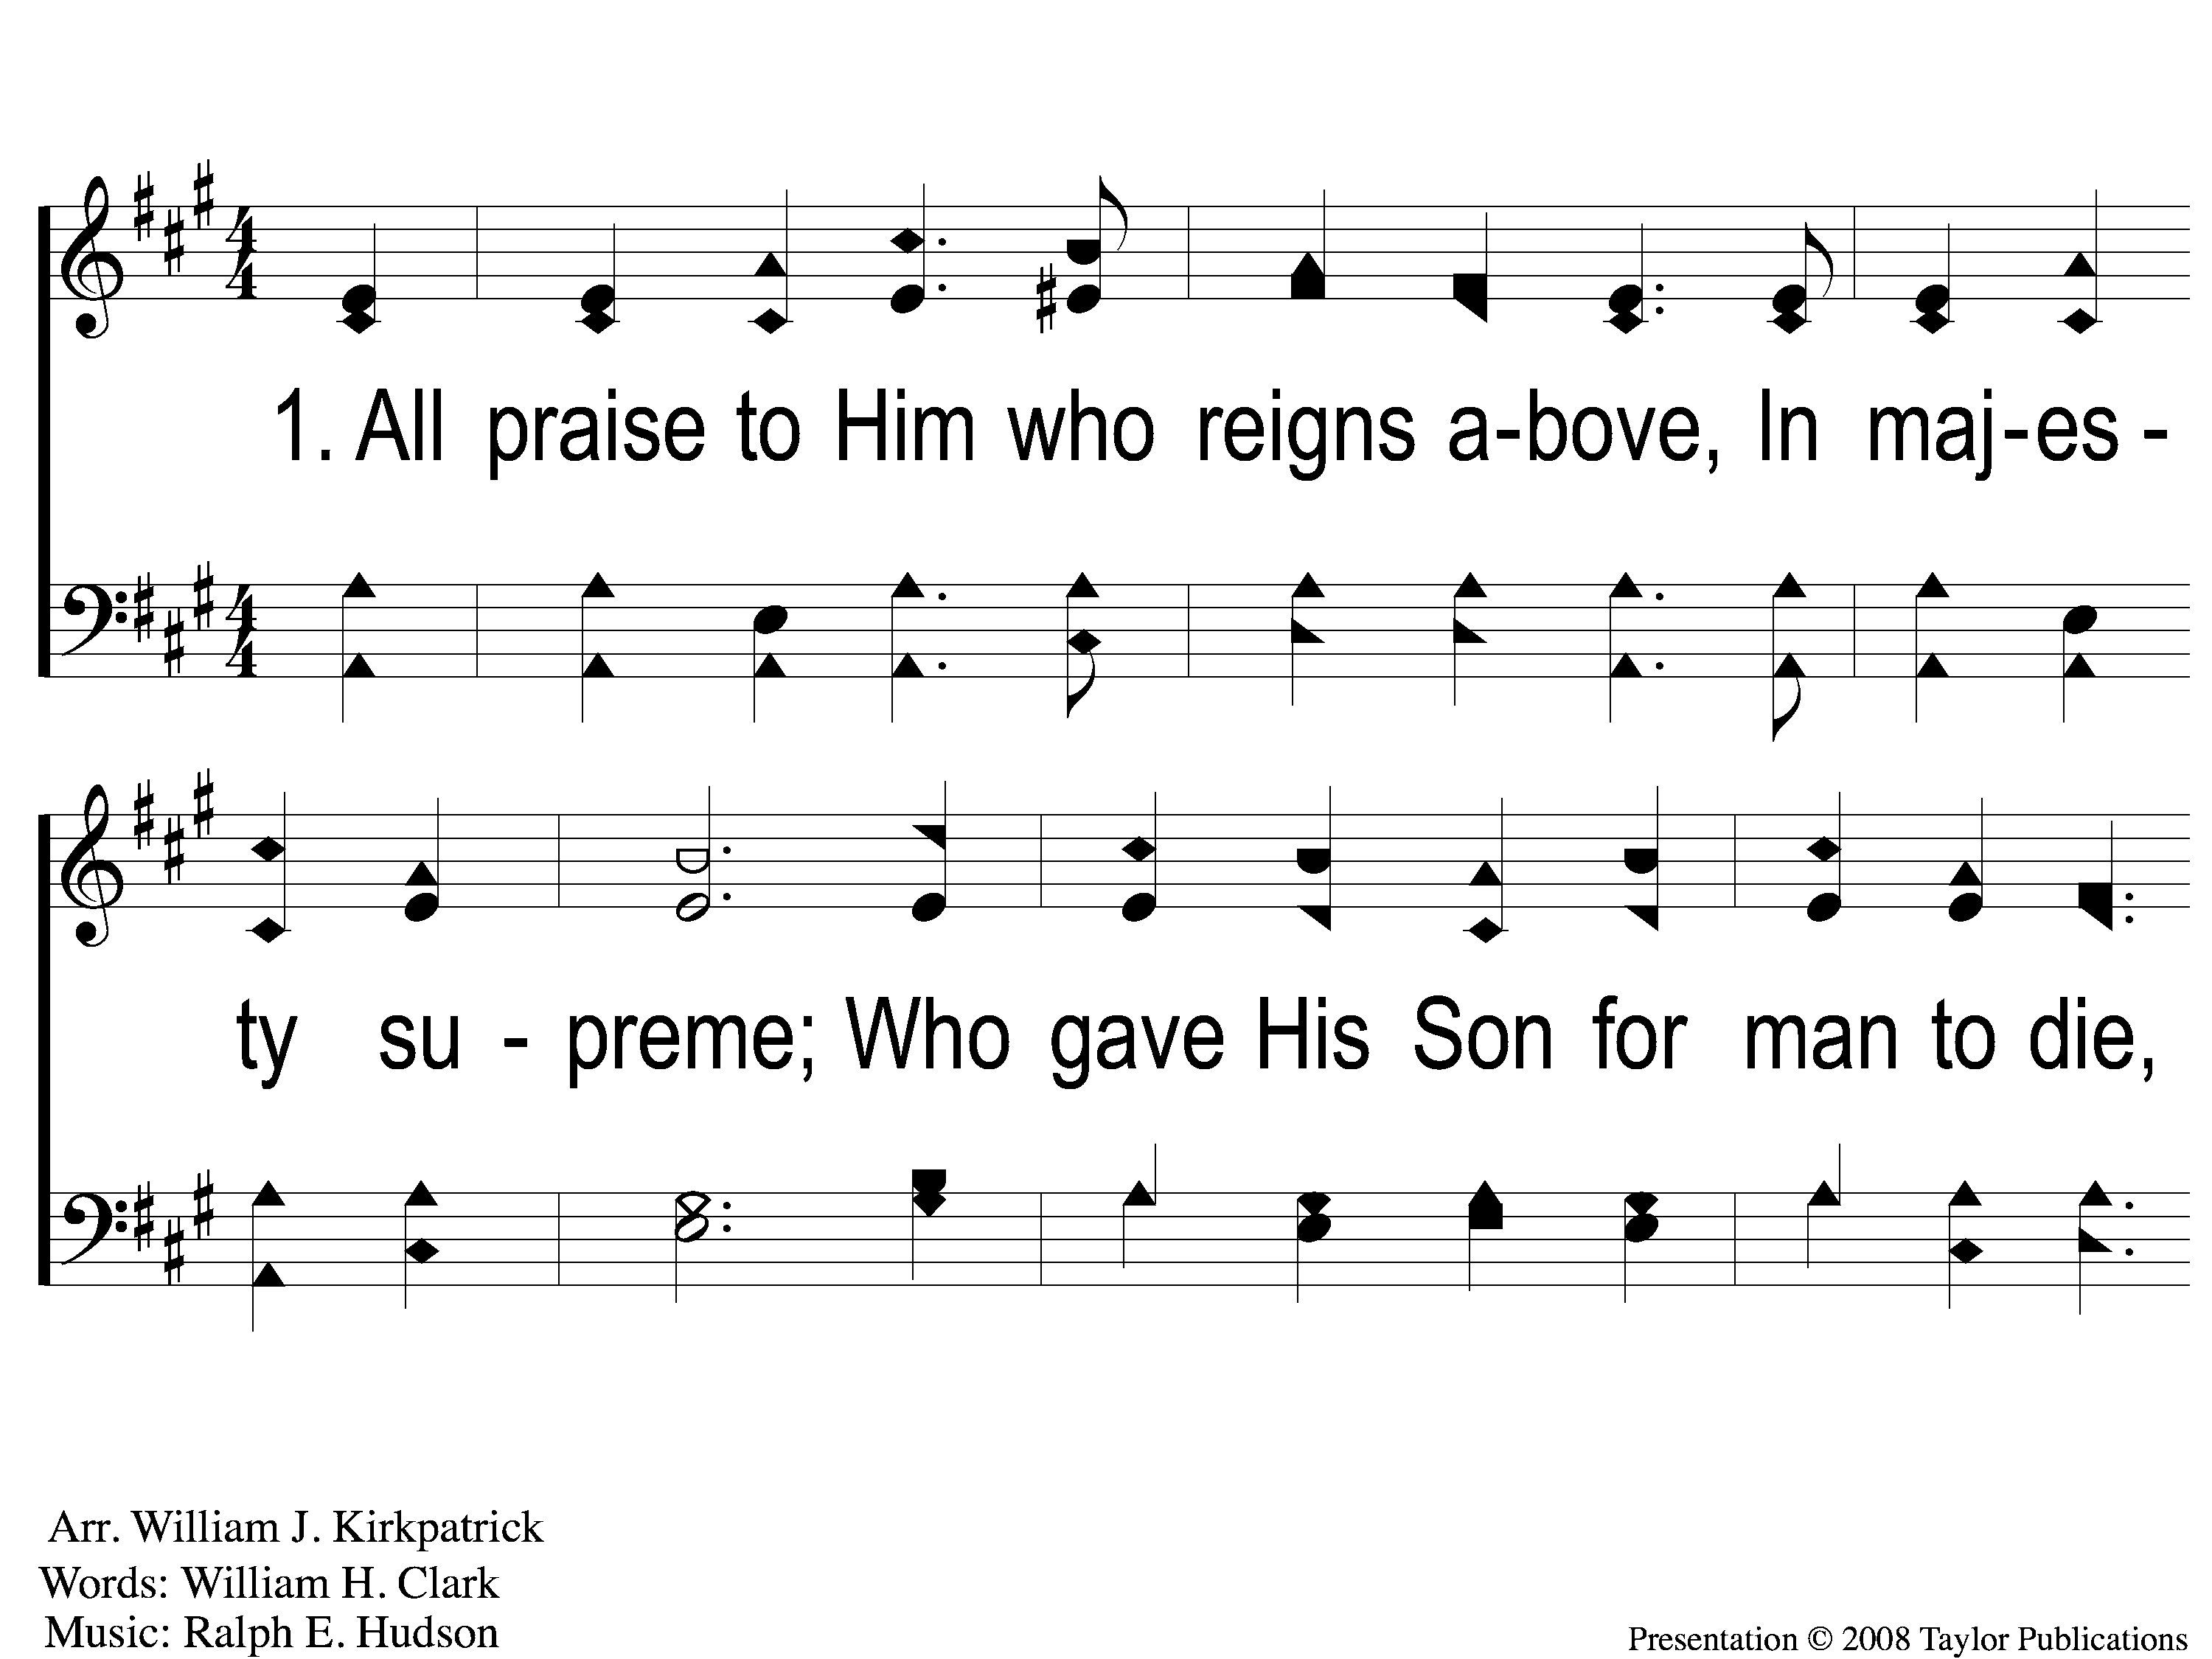
1-1 Blessed Be the Name
Blessed Be the Name
53

Slide 2
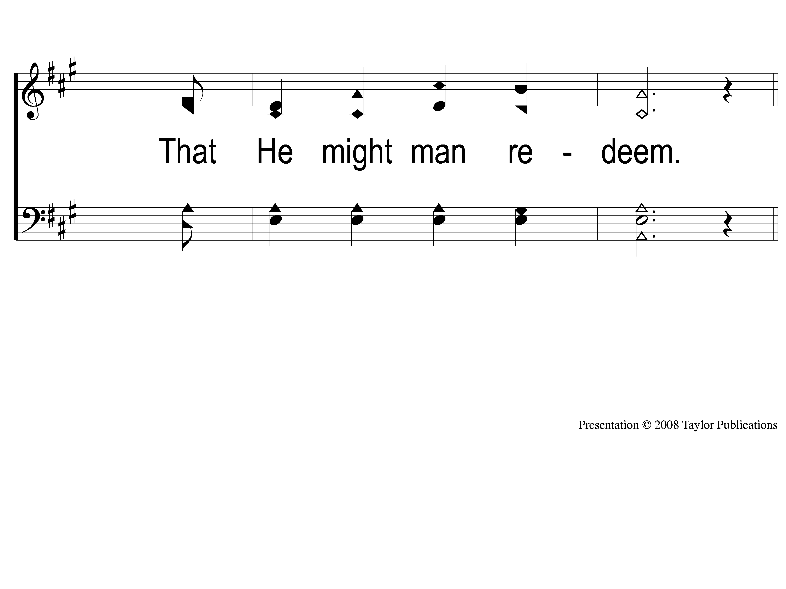
1-2 Blessed Be the Name
Blessed Be the Name
53

Slide 3
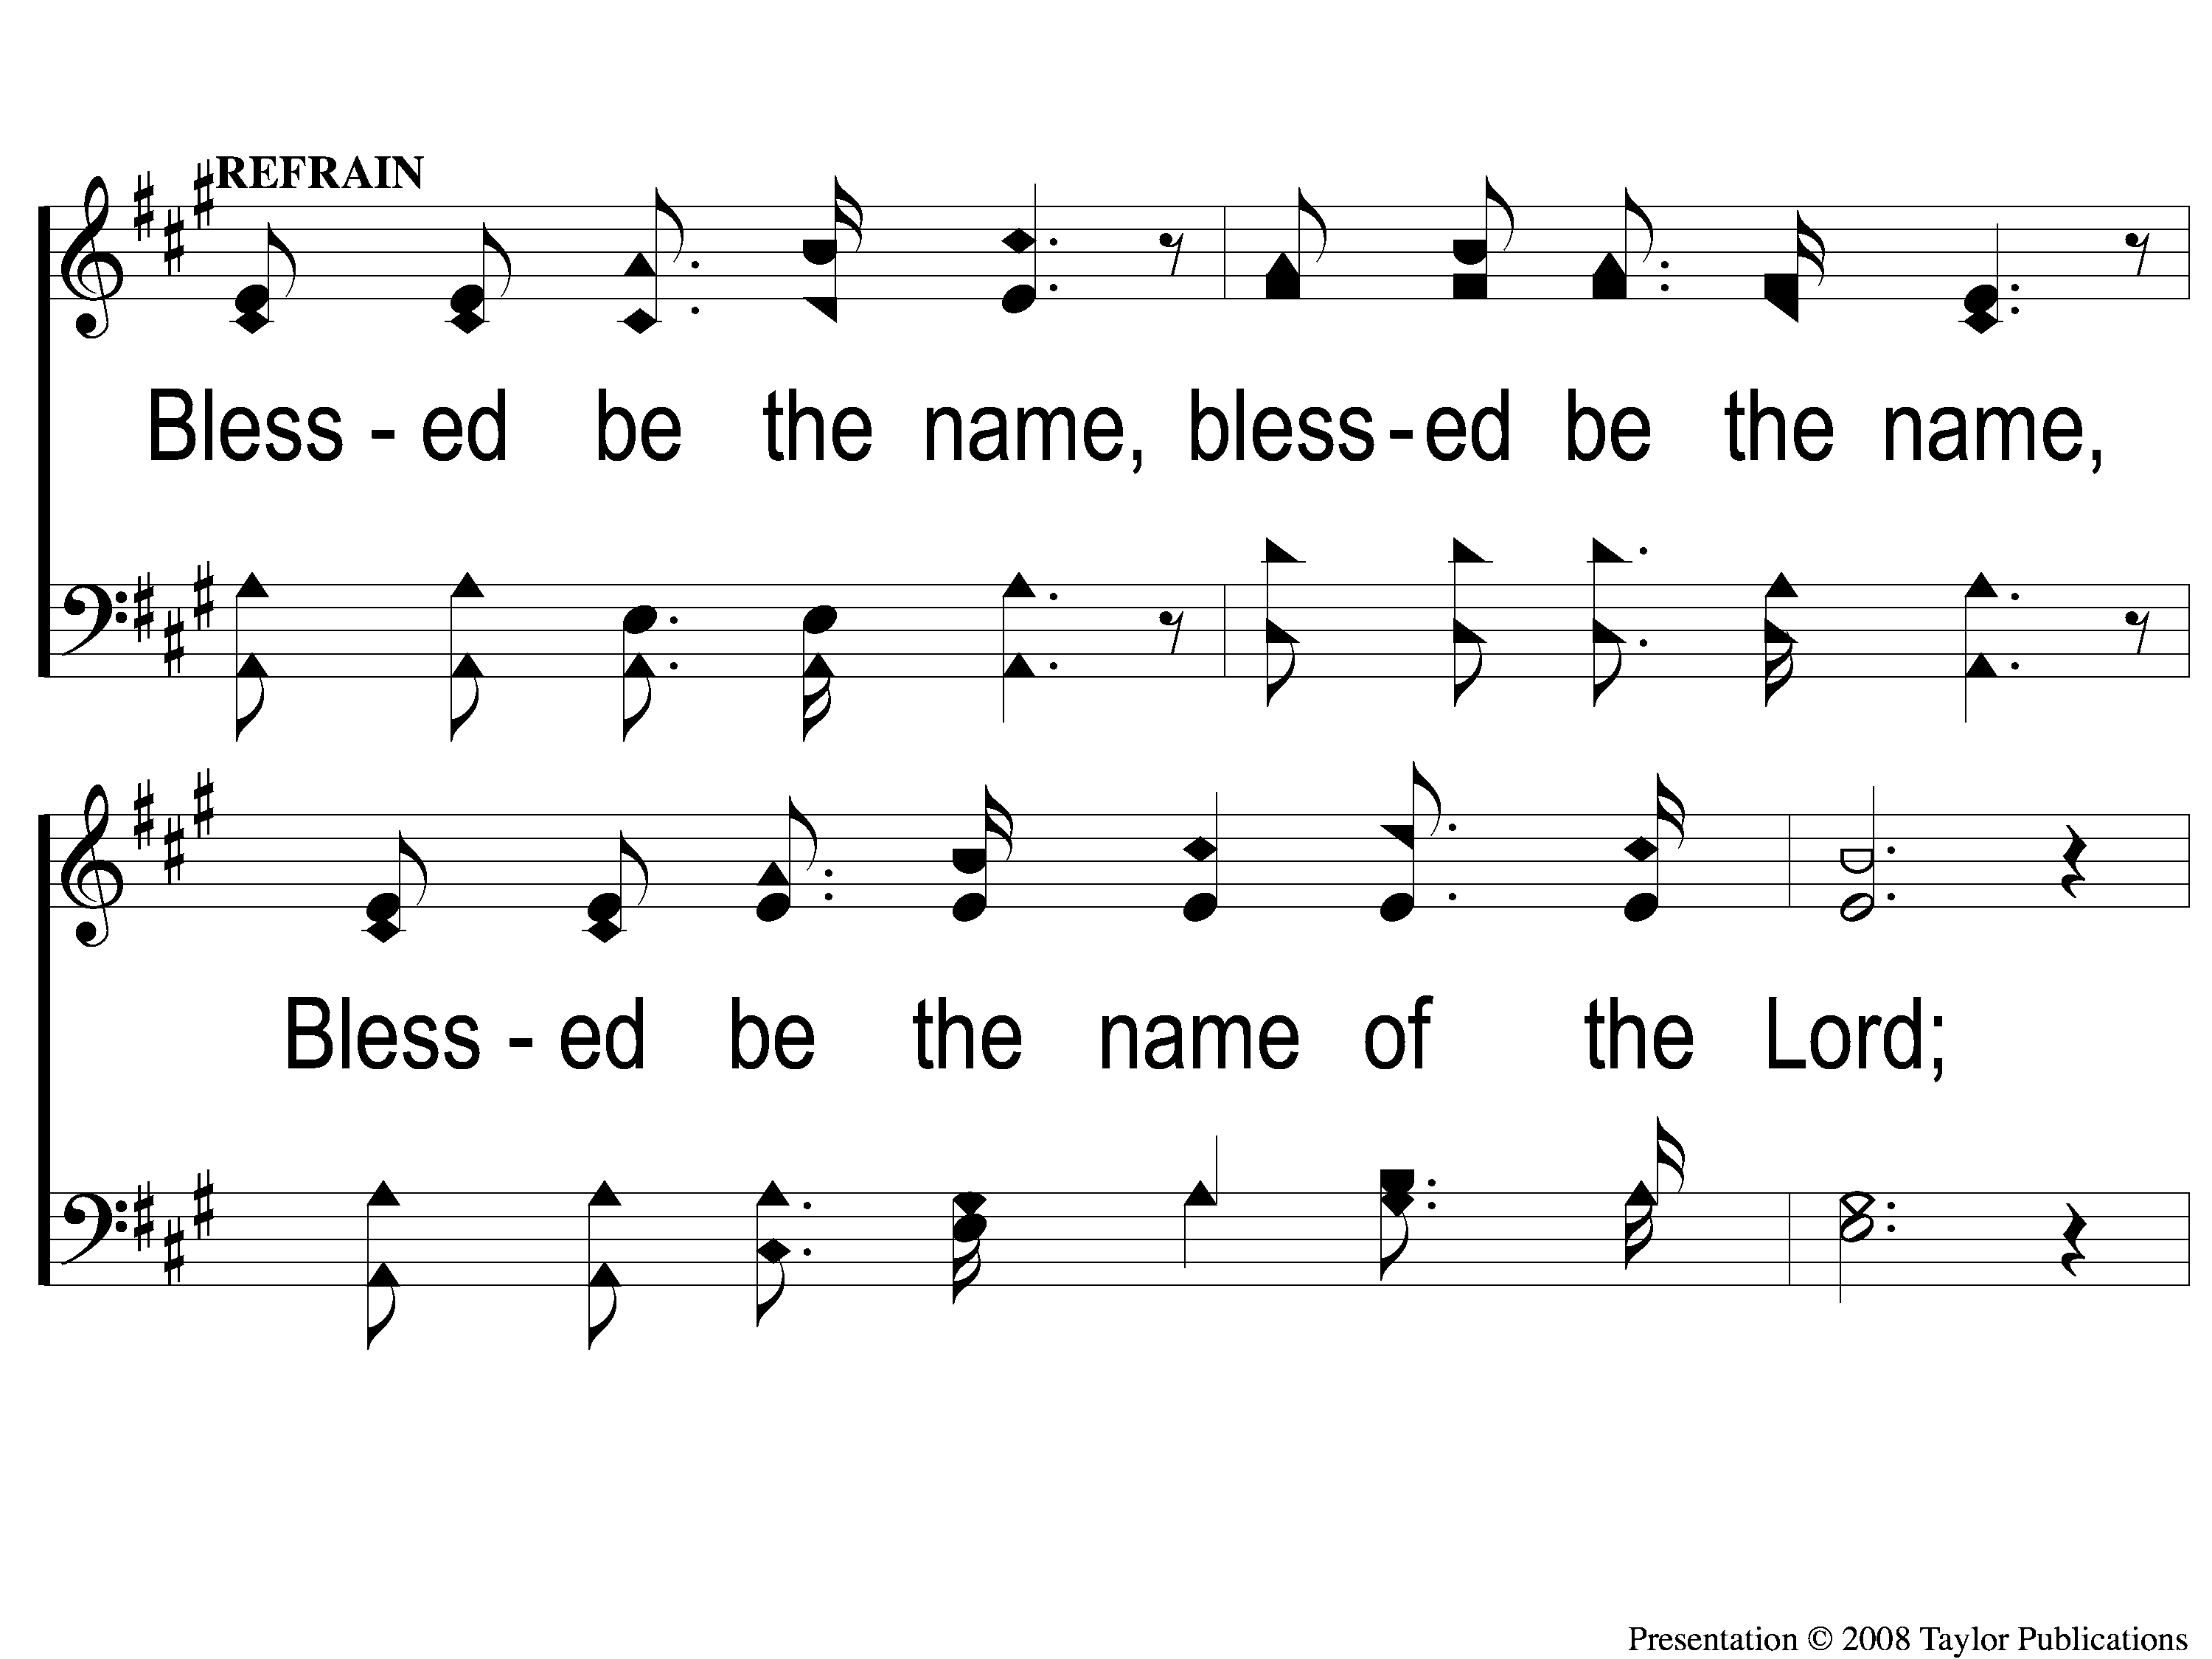
C-1 Blessed Be the Name
Blessed Be the Name
53

Slide 4
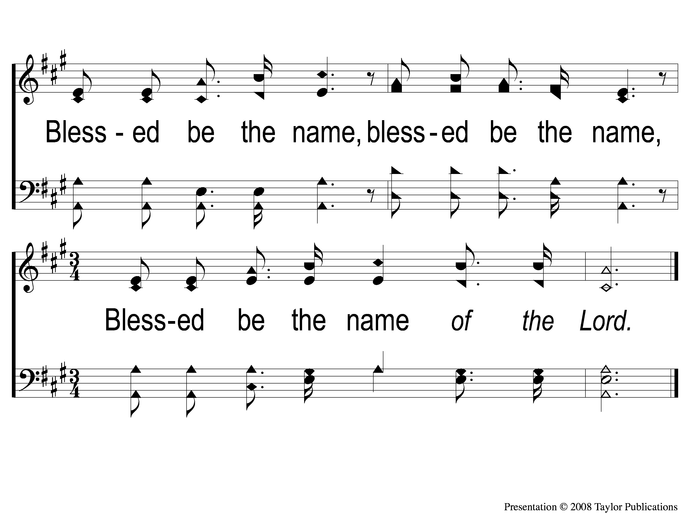
C-2 Blessed Be the Name
Blessed Be the Name
53

Slide 5
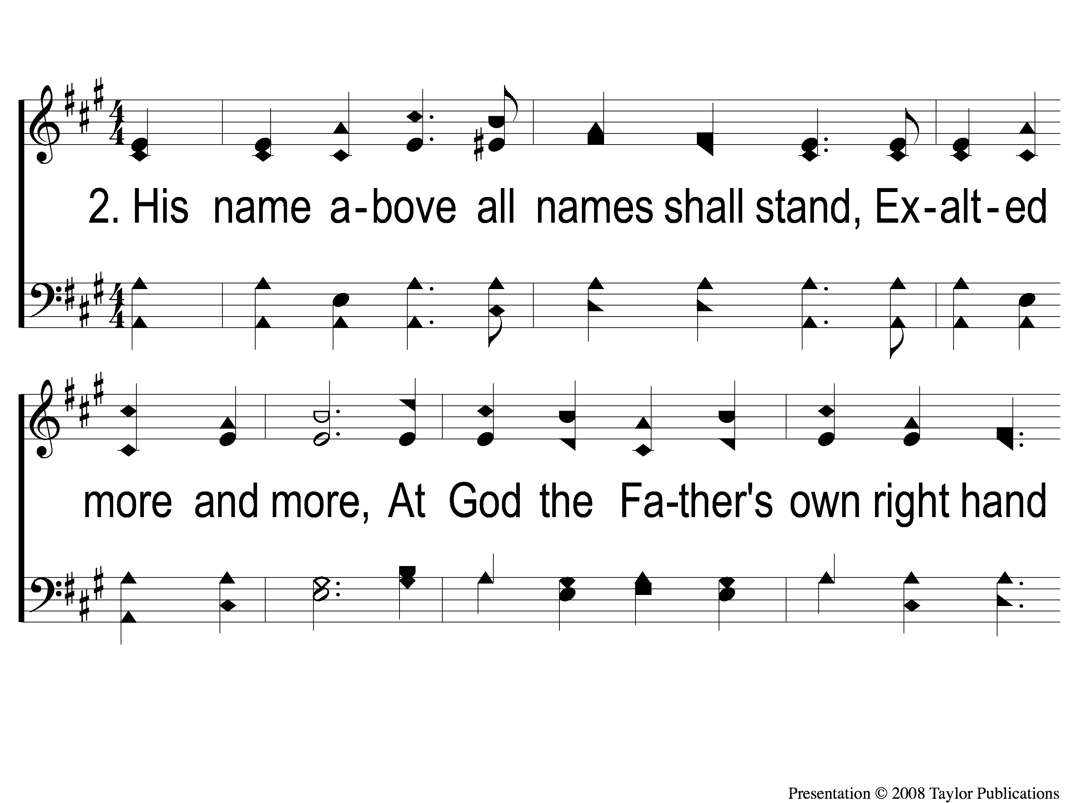
2-1 Blessed Be the Name
Blessed Be the Name
53

Slide 6
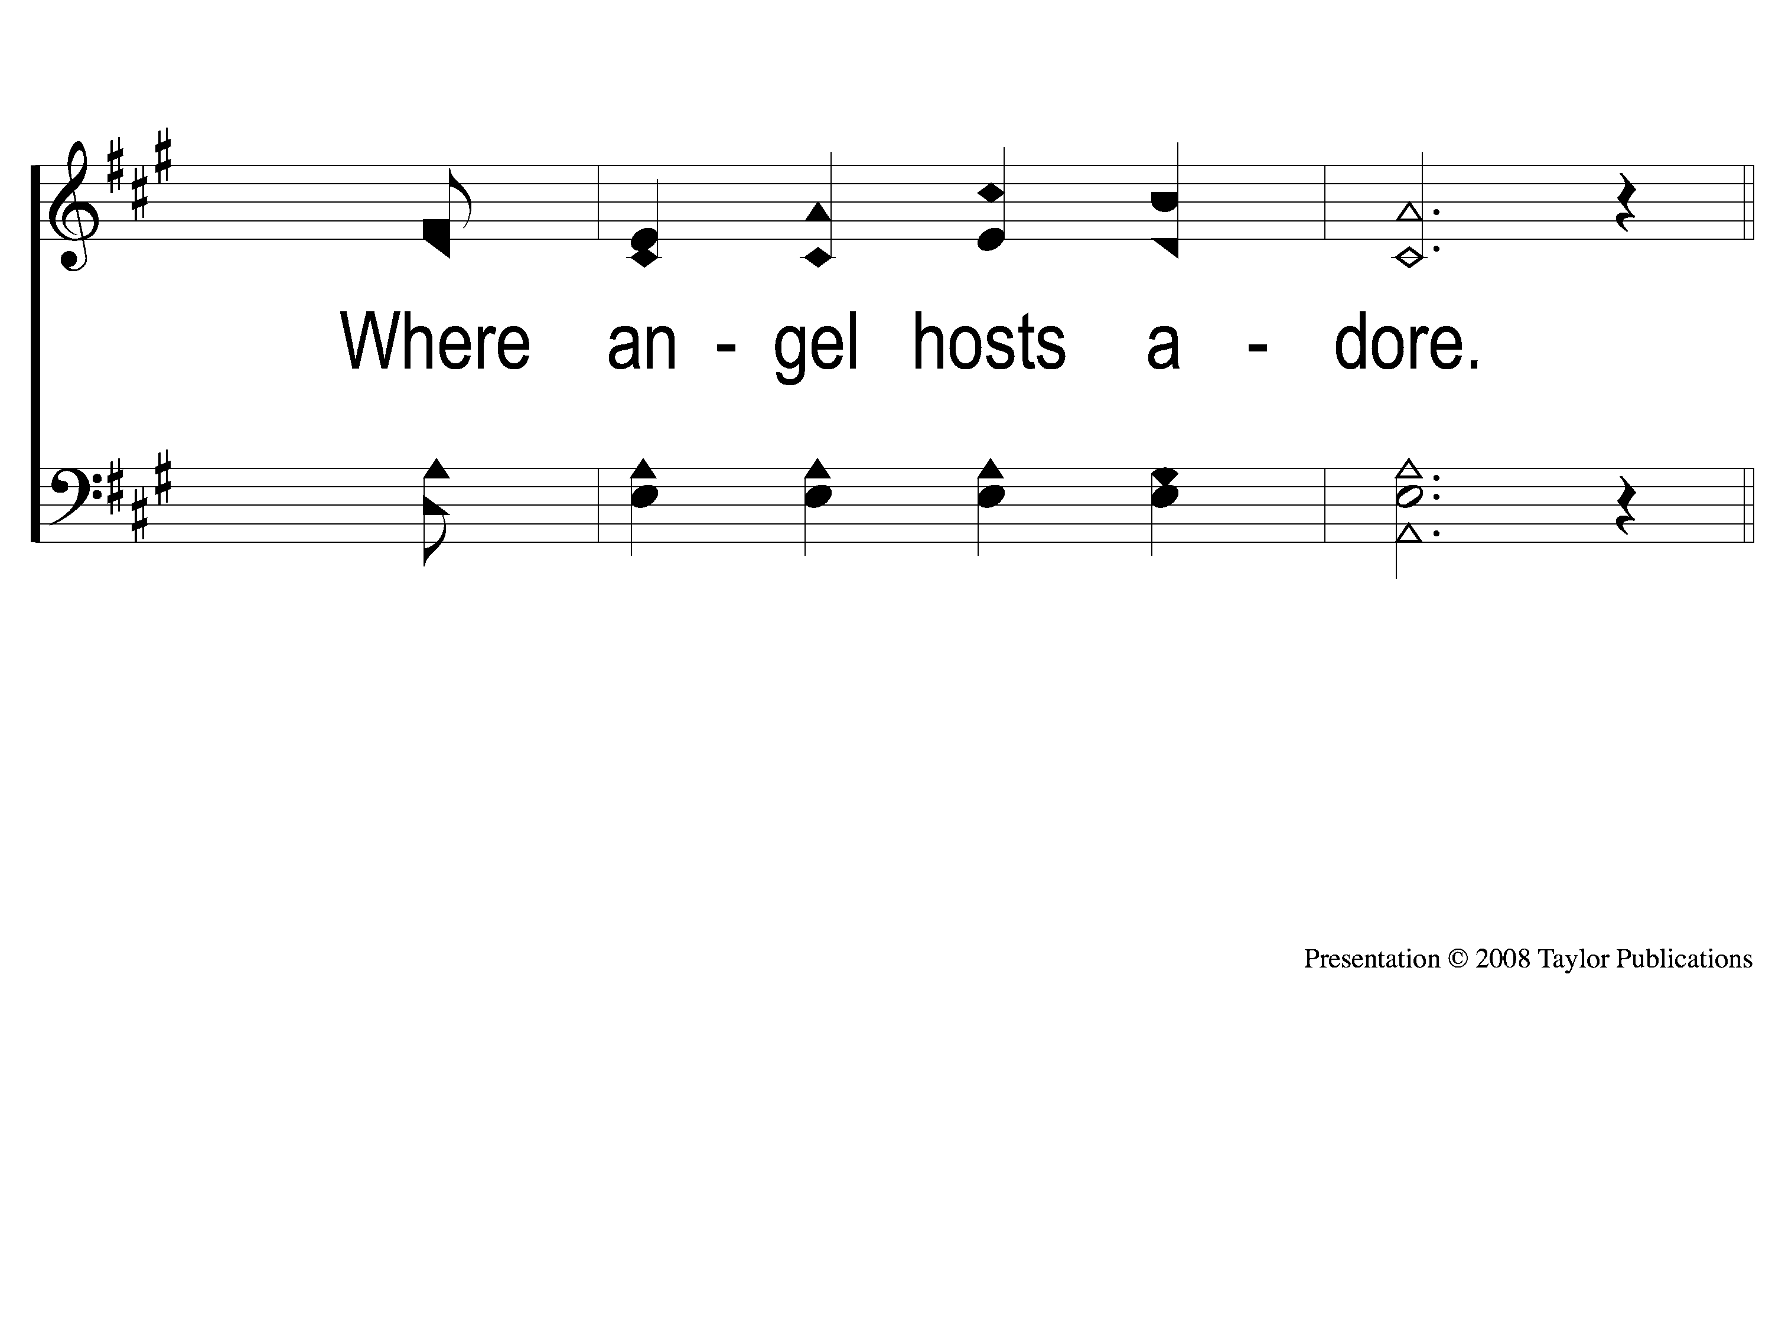
2-2 Blessed Be the Name
Blessed Be the Name
53

Slide 7
C-1 Blessed Be the Name
Blessed Be the Name
53

Slide 8
C-2 Blessed Be the Name
Blessed Be the Name
53

Slide 9
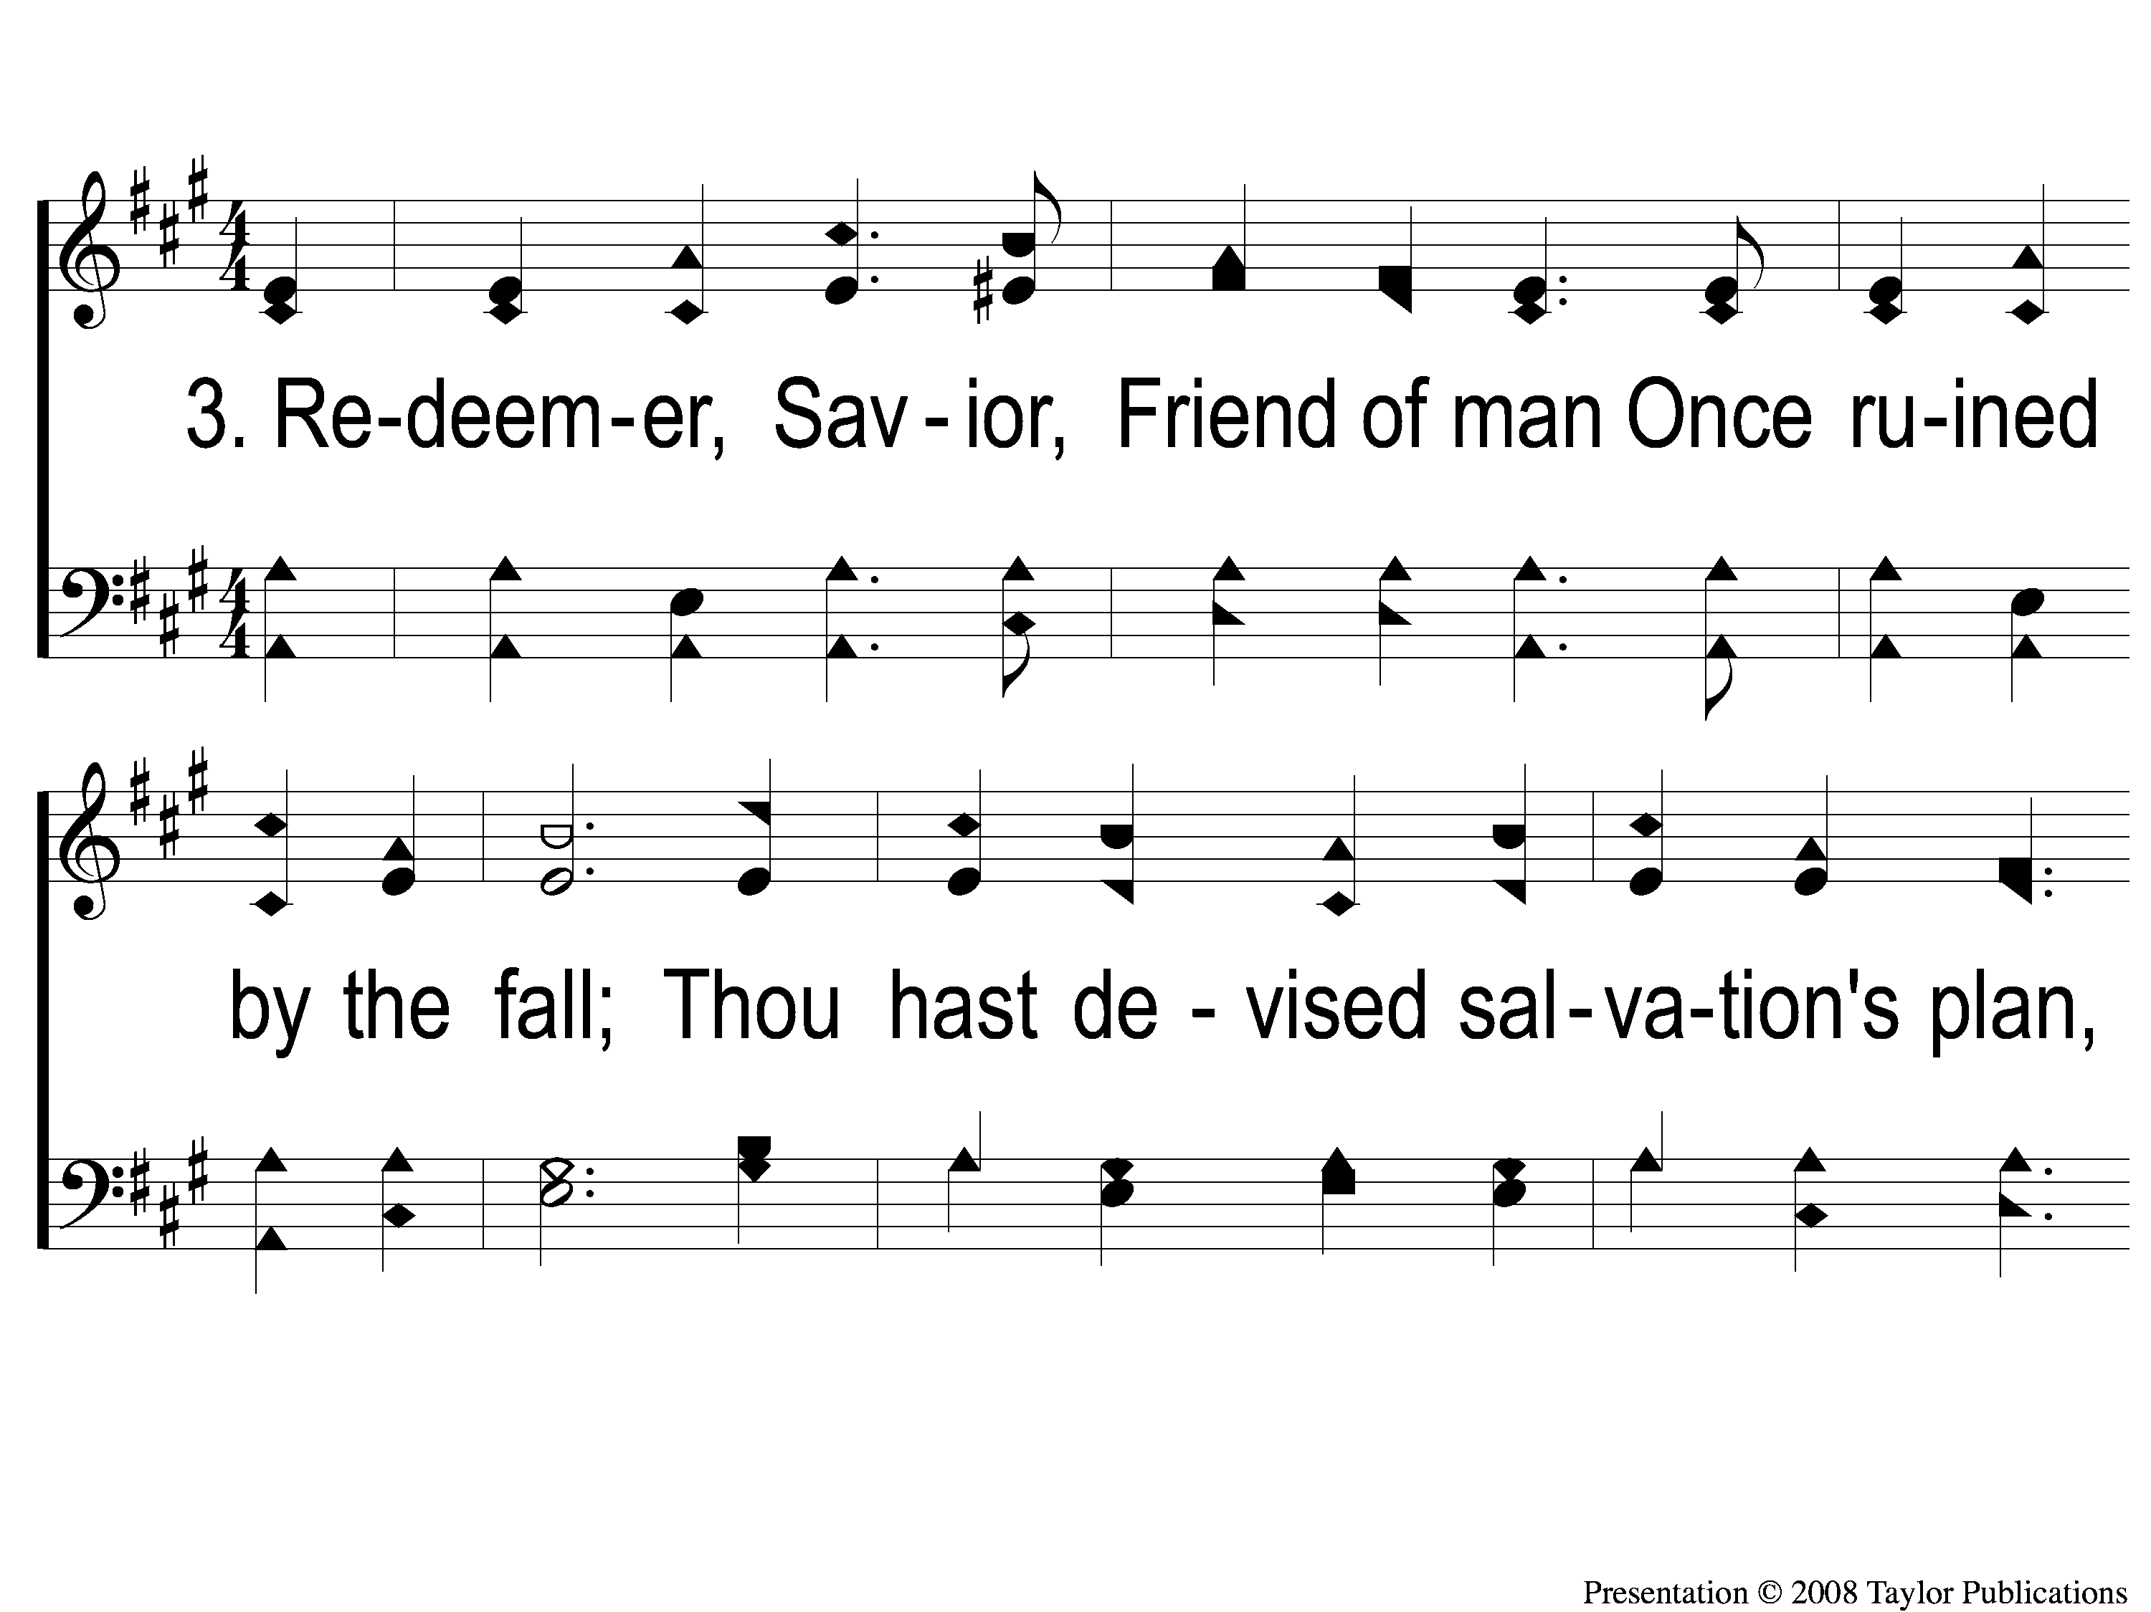
3-1 Blessed Be the Name
Blessed Be the Name
53

Slide 10
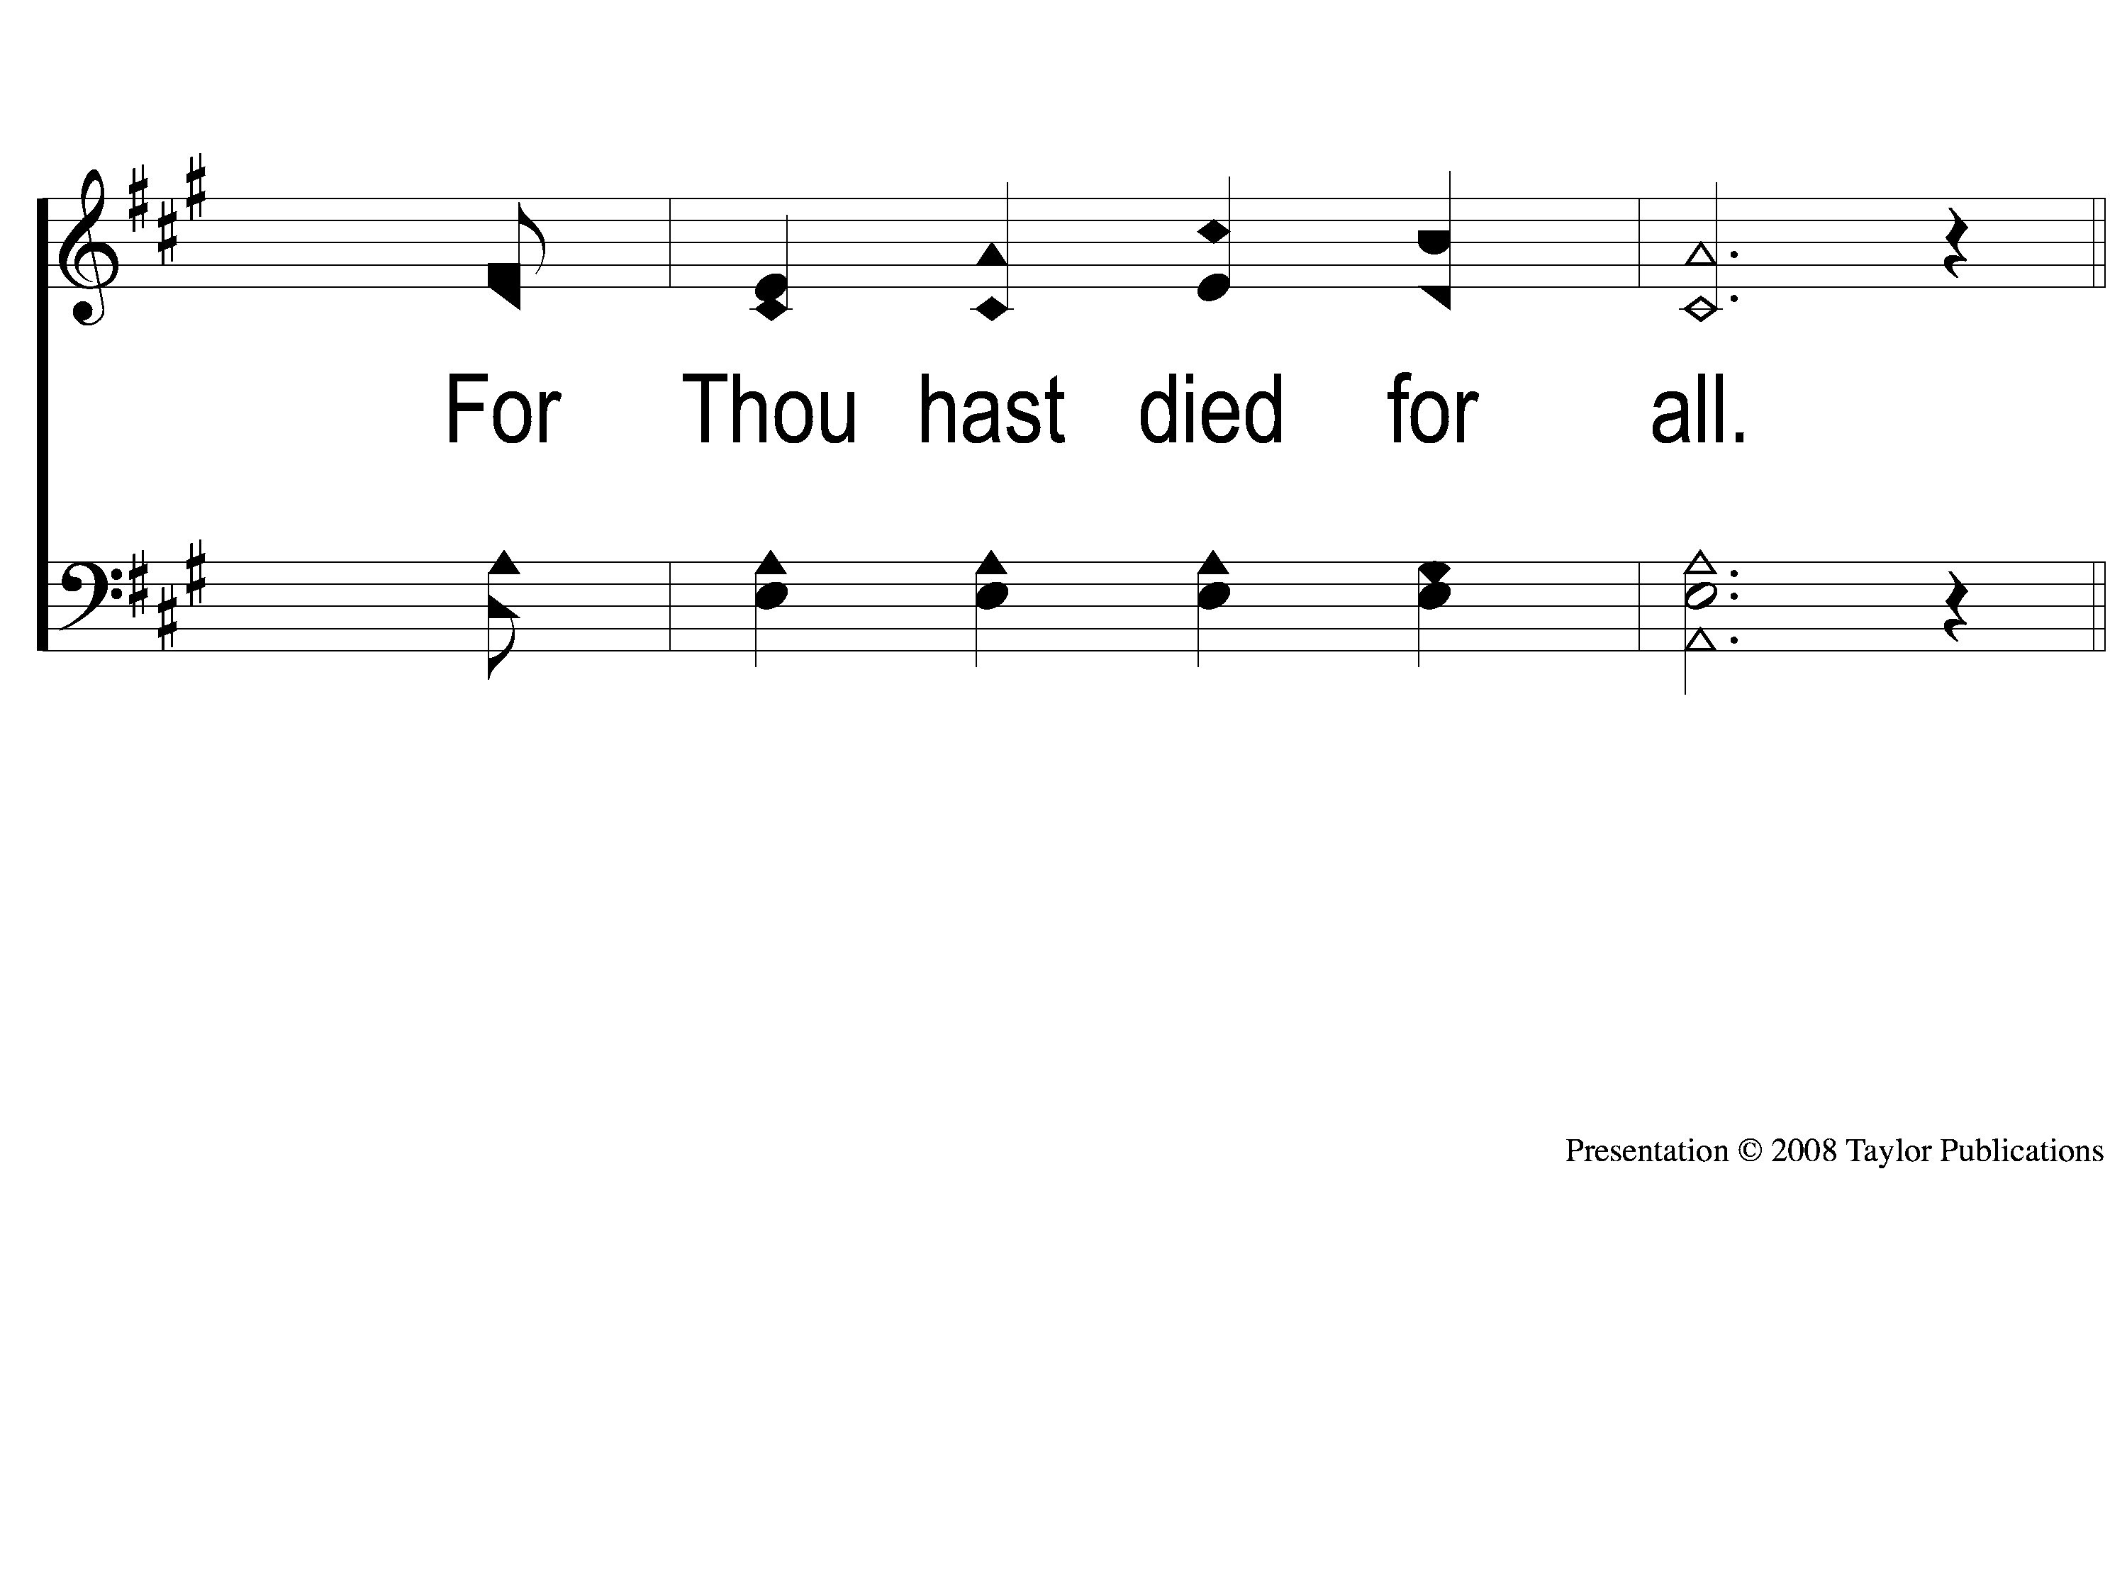
3-2 Blessed Be the Name
Blessed Be the Name
53

Slide 11
C-1 Blessed Be the Name
Blessed Be the Name
53

Slide 12
C-2 Blessed Be the Name
Blessed Be the Name
53

